Slide 1
Review of Semiconductor Physics, PN Junction Diodes and Resistors Sikandar Khan

Slide 2
Improving Conduction by Doping
To make semiconductors better conductors, add impurities (dopants) to contribute extra electrons or extra holes
elements with 5 outer electrons contribute an extra electron to the lattice (donor dopant)
elements with 3 outer electrons accept an electron from the silicon (acceptor dopant)

Slide 3
Improving Conduction by Doping (cont.)
Phosphorus and arsenic are donor dopants
if phosphorus is introduced into the silicon lattice, there is an extra electron “free” to move around and contribute to electric current
very loosely bound to atom and can easily jump to conduction band
produces n type silicon
sometimes use + symbol to indicate heavier doping, so n+ silicon
phosphorus becomes positive ion after giving up electron

Slide 4
Improving Conduction by Doping (cont.)
Boron has 3 electrons in its outer shell, so it contributes a hole if it displaces a silicon atom
boron is an acceptor dopant
yields p type silicon
boron becomes negative ion after accepting an electron

Slide 5
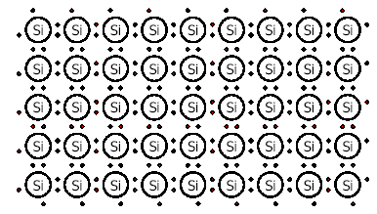
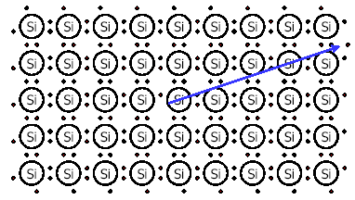
INTRINSIC (PURE) SILICON
Silicon has 4 valence electrons, it covalently bonds with four adjacent atoms in the crystal lattice
Higher temperatures create free charge carriers.
A “hole” is created in the absence of an electron.

Slide 6
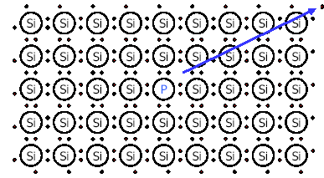
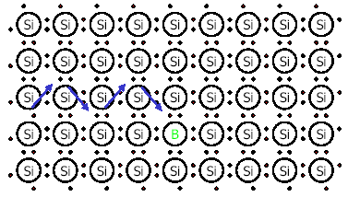
DOPING
There are two types of doping
N-type and P-type.
The N in N-type stands for negative.
A column V ion is inserted.
The extra valence electron is free to move about the lattice
The P in P-type stands for positive.
A column III ion is inserted.
Electrons from the surrounding Silicon move to fill the “hole.”

Slide 7
Energy-band Diagram
A very important concept in the study of semiconductors is the energy-band diagram
It is used to represent the range of energy a valence electron can have
For semiconductors the electrons can have any one value of a continuous range of energy levels while they occupy the valence shell of the atom
That band of energy levels is called the valence band
Within the same valence shell, but at a slightly higher energy level, is yet another band of continuously variable, allowed energy levels
This is the conduction band

Slide 8
Band Gap
Between the valence and the conduction band is a range of energy levels where there are no allowed states for an electron
This is the band gap

Slide 9
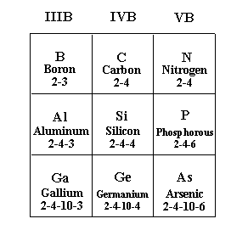
Impurities
Silicon crystal in pure form is good insulator - all electrons are bonded to silicon atom
Replacement of Si atoms can alter electrical properties of semiconductor
Group number - indicates number of electrons in valence level (Si - Group IV)

Slide 10
Impurities
Replace Si atom in crystal with Group V atom
substitution of 5 electrons for 4 electrons in outer shell
extra electron not needed for crystal bonding structure
can move to other areas of semiconductor
current flows more easily - resistivity decreases
many extra electrons --> “donor” or n-type material
Replace Si atom with Group III atom
substitution of 3 electrons for 4 electrons
extra electron now needed for crystal bonding structure
“hole” created (missing electron)
electrons needed --> “acceptor” or p-type material

Slide 11
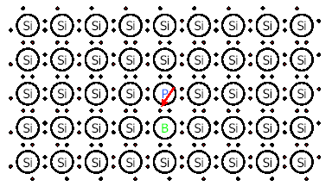
COUNTER DOPING
Insert more than one type of Ion
The extra electron and the extra hole cancel out

Slide 12
A LITTLE MATH
n= number of free electrons
p=number of holes
ni=number of electrons in intrinsic silicon=10¹º/cm³
pi-number of holes in intrinsic silicon= 10¹º/cm³
Mobile negative charge = -1.6*10⁻¹⁹ Coulombs
Mobile positive charge = 1.6*10⁻¹⁹ Coulombs

Slide 13
What are P-type and N-type ?
Semiconductors are classified in to P-type and N-type semiconductor
P-type: A P-type material is one in which holes are majority carriers i.e. they are positively charged materials (++++)
N-type: A N-type material is one in which electrons are majority charge carriers i.e. they are negatively charged materials (-----)

Slide 14
P-N Junction
Also known as a diode
One of the basics of semiconductor technology -
Created by placing n-type and p-type material in close contact
Diffusion - mobile charges (holes) in p-type combine with mobile charges (electrons) in n-type

Slide 15
Types of Semiconductor Materials
The silicon doped with extra electrons is called an “N type” semiconductor.
“N” is for negative, which is the charge of an electron.
Silicon doped with material missing electrons that produce locations called holes is called “P type” semiconductor.
“P” is for positive, which is the charge of a hole.

Slide 16
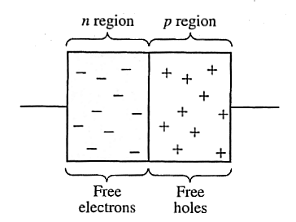
Diodes
Electronic devices created by bringing together a p-type and n-type region within the same semiconductor lattice. Used for rectifiers, LED etc

Slide 17
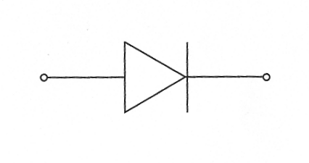
Diodes
It is represented by the following symbol, where the arrow indicates the direction of positive current flow.

Slide 18
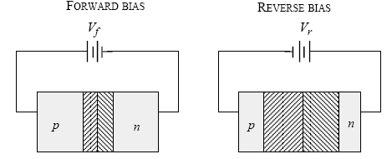
Forward Bias and Reverse Bias
Forward Bias : Connect positive of the Diode to positive of supply…negative of Diode to negative of supply
Reverse Bias: Connect positive of the Diode to negative of supply…negative of diode to positive of supply.

Slide 19
Characteristics of Diode
Diode always conducts in one direction.
Diodes always conduct current when “Forward Biased” ( Zero resistance)
Diodes do not conduct when Reverse Biased
(Infinite resistance)

Slide 20
N-type Semiconductor
Free electron
Si
P
Si
Si
Si
Impure atom
(Donor)

Slide 21
P-type semiconductors
Hole
Co-Valent
bonds
Si
In
Si
Si
Si
Impure atom
(acceptor)

Slide 22
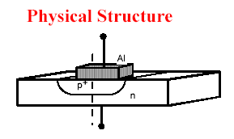
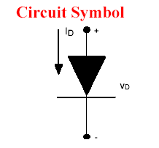
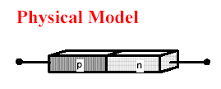
THE P-N JUNCTION

Slide 23
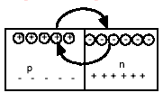
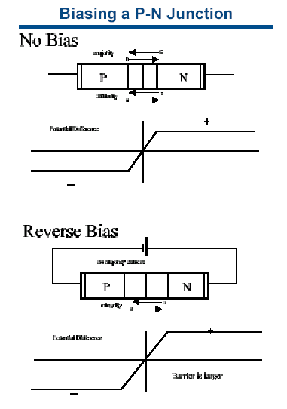

The Junction
↓
The “potential” or voltage across the silicon changes in the depletion region and goes from + in the n region to – in the p region

Slide 24
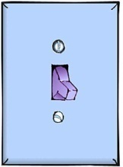
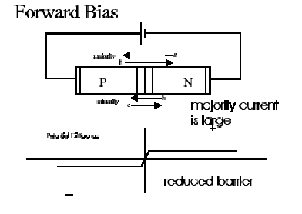
Biasing the P-N Diode
THINK OF THE DIODE AS A SWITCH
Forward Bias
Applies - voltage to the n region and + voltage to the p region
CURRENT!
Reverse Bias
Applies + voltage to n region and – voltage to p region
NO CURRENT

Slide 25
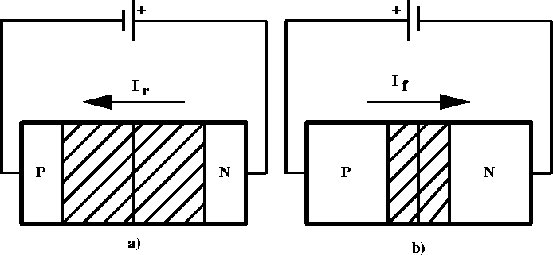
P-N Junction – Forward Bias
positive voltage placed on p-type material
holes in p-type move away from positive terminal, electrons in n-type move further from negative terminal
depletion region becomes smaller - resistance of device decreases
voltage increased until critical voltage is reached, depletion region disappears, current can flow freely

Slide 26
P-N Junction – Reverse Bias
positive voltage placed on n-type material
electrons in n-type move closer to positive terminal, holes in p-type move closer to negative terminal
width of depletion region increases
allowed current is essentially zero (small “drift” current)

Slide 27
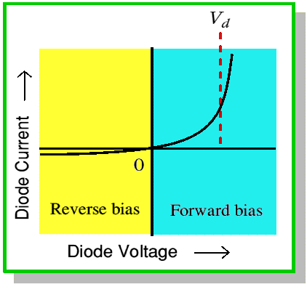
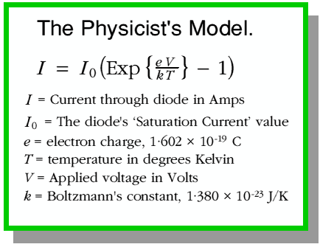
P-N Junction - V-I characteristics
Voltage-Current relationship for a p-n junction (diode)

Slide 28
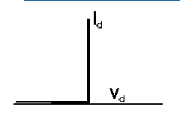
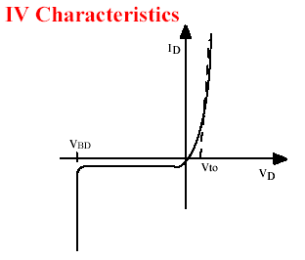
Current-Voltage Characteristics
THE IDEAL DIODE
Positive voltage yields finite current
Negative voltage yields zero current
REAL DIODE

